Slide 1
Types of Forces

Slide 2
Mechanics:
In the last unit, we dealt with Kinematics.
Kinematics is the study of moving objects without being concerned with why they move.
In the next unit, we are dealing with Dynamics.
Dynamics is the study of the forces that are acting on objects causing the motion.
Forces: are effect that cause the objects to start moving, speed up, slow down, remain stationary, or change their direction.

Slide 3
Forces:
Measuring Forces:
The newton (N) is a derived SI unit equal to 1 kg·m/s²
1 N = 1 kg.m/s²
Free Body Diagrams:
is a sketch showing all the forces that are acting on objects.
The FBD for the book shown in the given figure shows all the forces acting on a book.
Two forces are drawn: the force of the hand (applied force) pulling up and the force of gravity pulling down.

Slide 4
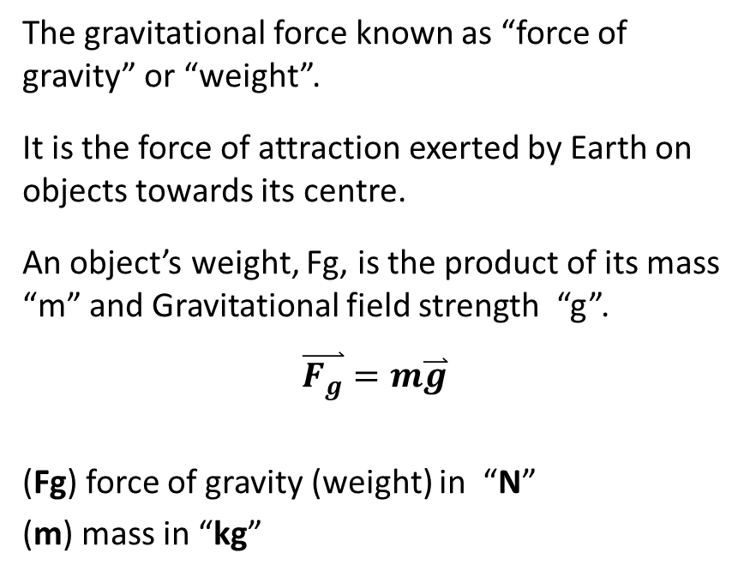
Gravitational Force (Fg):
The gravitational force known as “force of gravity” or “weight”.
It is the force of attraction exerted by Earth on objects towards its centre.
An object’s weight, Fg, is the product of its mass “m” and Gravitational field strength “g”.
$$\overset{⃑}{F_{g}}=m\overset{⃑}{g}$$
(Fg) force of gravity (weight) in “N”
(m) mass in “kg”
(g) gravitational field strength “9.81 N/kg [ down]”

Slide 5
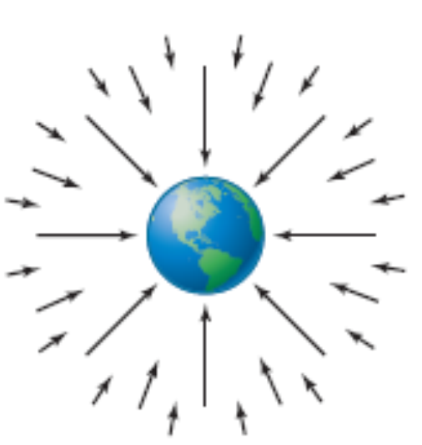
Gravitational Field Strength
Force field: a region of space surrounding an object that can exert a force on other objects that are placed within that region.
Gravitational field strength: the force per unit mass acting on an object when placed in a gravitational field
At Earth’s surface, the gravitational field strength is g = 9.81 N/kg [down].
Notice that this has the same magnitude as the acceleration due to gravity at Earth’s surface g = 9.81 m/s² [down].
In other words, the gravitational field strength at a location has the same magnitude as the acceleration due to gravity at that location.

Slide 6

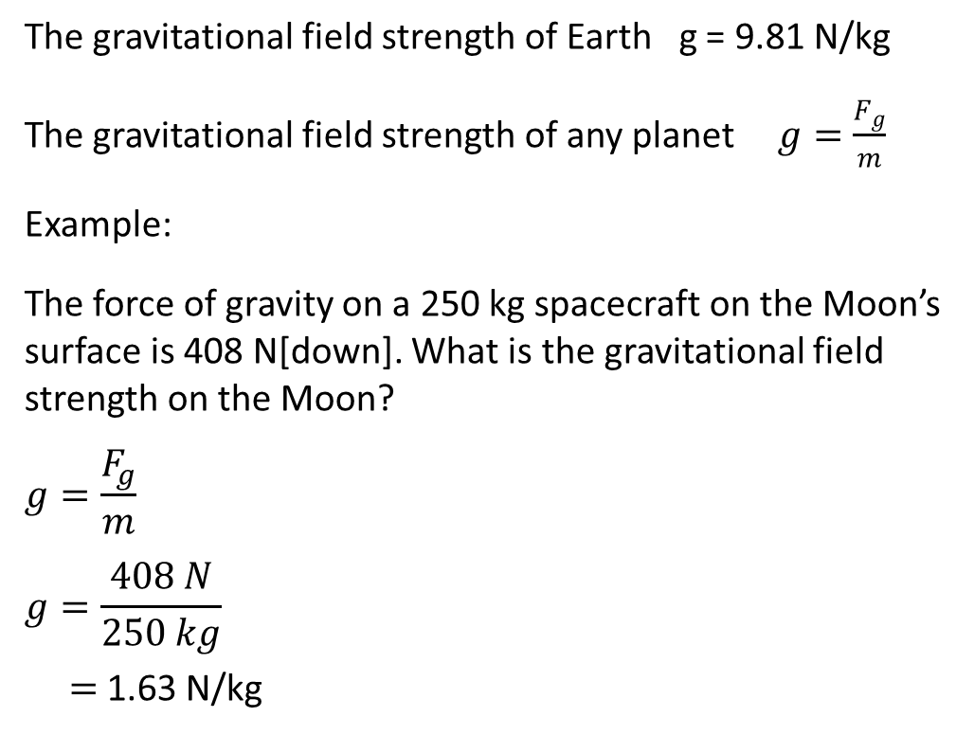

The gravitational field strength of Earth g = 9.81 N/kg
The gravitational field strength of any planet $g=\frac{F_{g}}{m}$
Example:
The force of gravity on a 250 kg spacecraft on the Moon’s surface is 408 N[down]. What is the gravitational field strength on the Moon?
$$g=\frac{F_{g}}{m}$$
$$g=\frac{408 N}{250 kg}$$
$=$1.63 N/kg
$$F_{N}$$
250 kg
$F_{g}$=408 N

Slide 7


Applied force (Fa):
a force that results when one object makes contact with another and pushes or pulls on it.
a force exerted by string or rope on object.
Example:
Identify the forces acting on the car that is pulled up by a crane.
Gravitational force and tension force.
Tension force (F_{T}):
$$F_{T}$$
m
$$F_{g}$$

Slide 8


Normal Force(F_{N}):
A force exerted by an object causing pressure on a surface. The surface is reacting by the normal force.
The normal force is perpendicular to the surface of contact and pointing away from it.
Example:
Identify the forces acting on the cup for the FBD.
Gravitational force and normal force
$$F_{N}$$
m
$$F_{g}$$

Slide 9
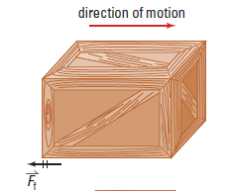





Friction Force(F_{f}):
is the force that opposes sliding an object (surface) on another surfaces.
Friction force acts parallel to the surface of contact and opposite to the direction motion.
Example:
Identify the forces acting on a box on the ground pulled by a rope and it is sliding for FBD.
Gravitational force, normal force, tension, and friction force.
Rope
$$F_{N}$$
$$F_{f}$$
$$F_{T}$$
m
$$F_{g}$$

Slide 10
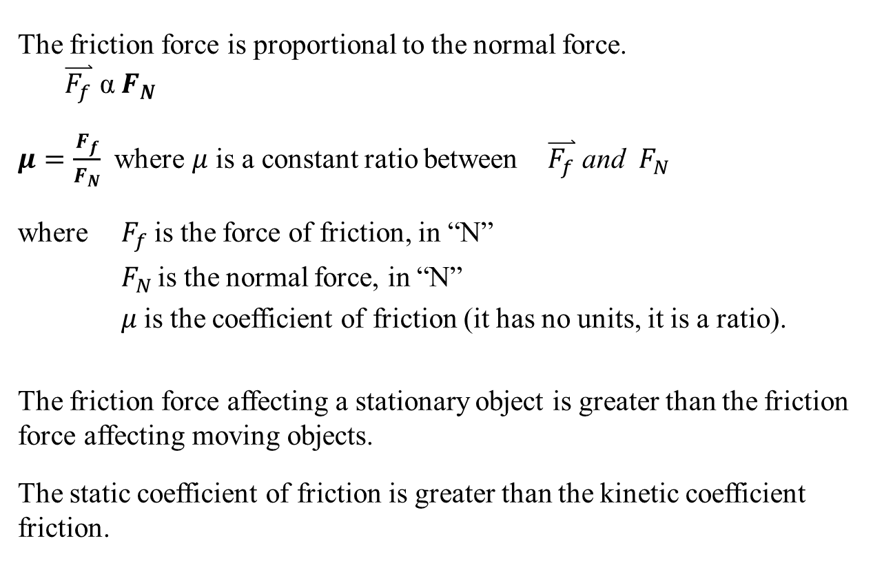
Friction Force(F_{f}):
The friction force is proportional to the normal force.
$$\overset{⃑}{F_{f}} \text{α} F_{N}$$
$μ=\frac{F_{f}}{F_{N}}$ where $μ$ is a constant ratio between $\overset{⃑}{F_{f}} \text{and} F_{N}$
where $F_{f}$is the force of friction, in “N”
$F_{N }$is the normal force, in “N”
$μ$is the coefficient of friction (it has no units, it is a ratio).
The friction force affecting a stationary object is greater than the friction force affecting moving objects.
The static coefficient of friction is greater than the kinetic coefficient friction.

Slide 11
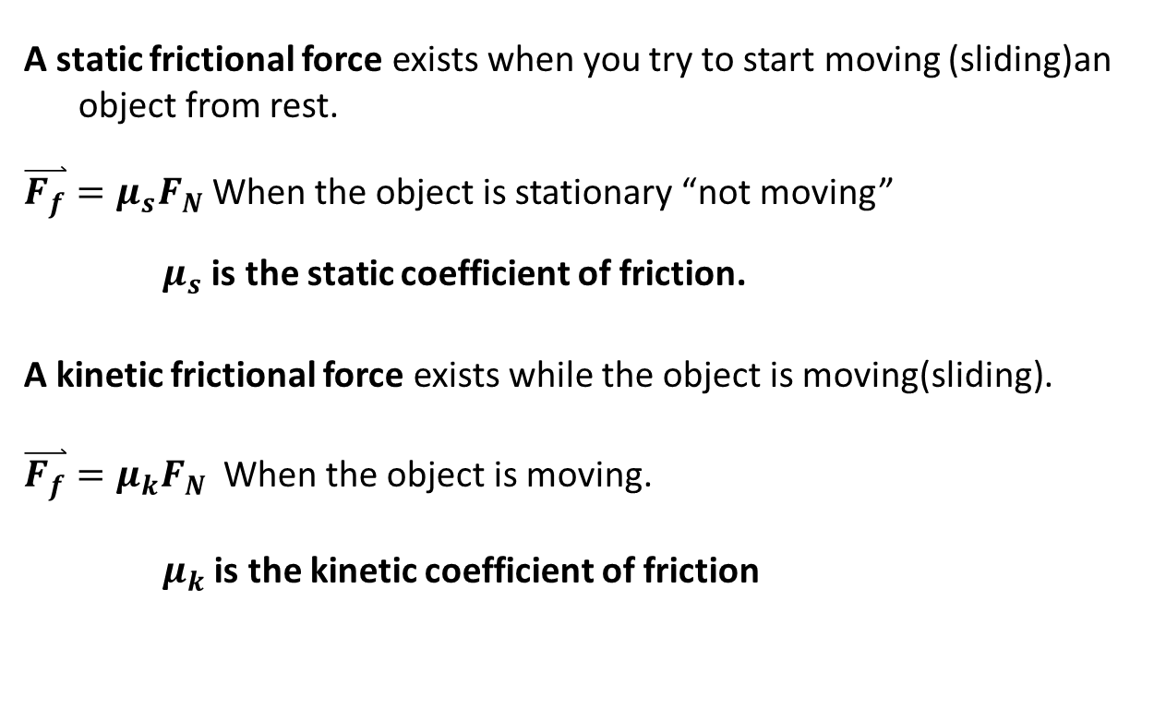
Friction Force(F_{f}):
A static frictional force exists when you try to start moving (sliding)an object from rest.
$\overset{⃑}{F_{f}}=μ_{s}F_{N}$ When the object is stationary “not moving”
$μ_{s}$ is the static coefficient of friction.
A kinetic frictional force exists while the object is moving(sliding).
$\overset{⃑}{F_{f}}=μ_{k}F_{N}$ When the object is moving.
$μ_{k}$ is the kinetic coefficient of friction

Slide 12
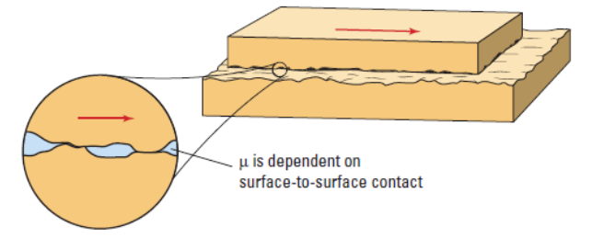
Coefficient of Friction ($μ_{s}$ / $μ_{k}$):
It depends on each of the two sliding surfaces on each other and must be experimentally obtained.

Slide 13
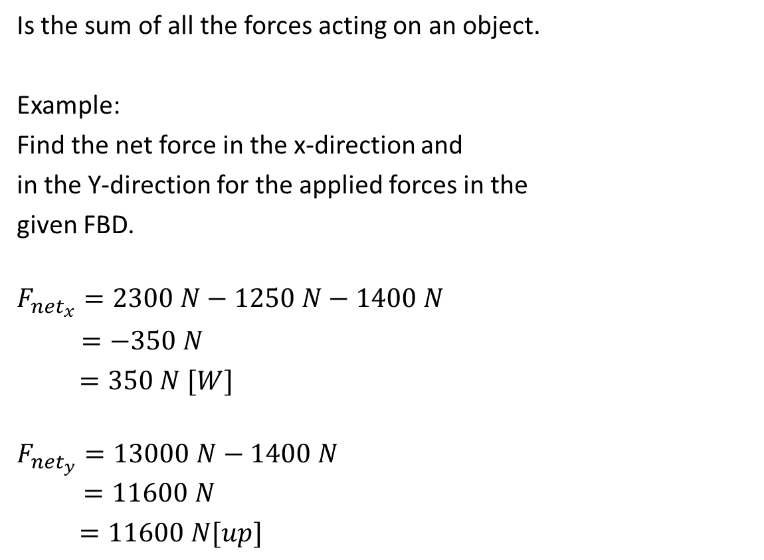
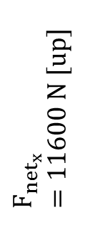

The Net Force ($F_{net}$):
Is the sum of all the forces acting on an object.
Example:
Find the net force in the x-direction and
in the Y-direction for the applied forces in the
given FBD.
$$F_{{net}_{x}}=2300 N−1250 N−1400 N$$
$=−350 N$
$=350 N [W]$
$$F_{{net}_{y}}=13000 N−1400 N$$
$$=11600 N$$
$=11600 N[up]$
$$F_{{net}_{x}}=350 N[W]$$
$$F_{{net}_{x}}=11600 N [up]$$

Slide 14

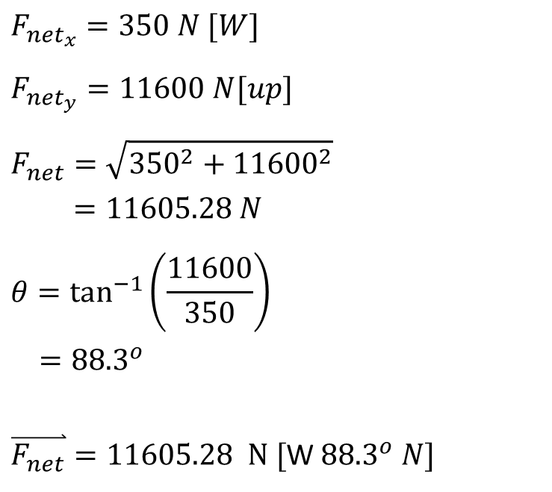
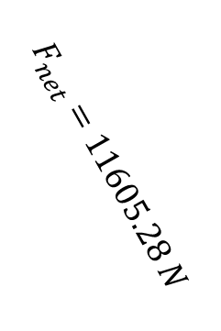
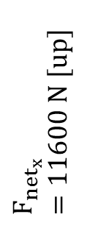
$$F_{{net}_{x}}=350 N [W]$$
$$F_{{net}_{y}}=11600 N[up]$$
$$F_{net}=\sqrt{{350}^{2}+{11600}^{2}}$$
$=11605.28 N$
$$θ=\tan^{−1}\left(\frac{11600}{350}\right)$$
$={88.3}^{o}$
$\overset{⃑}{F_{net}}=11605.28 N [$W ${88.3}^{o} N]$
$$F_{net}=11605.28 N$$
$$F_{{net}_{x}}=11600 N [up]$$
Ɵ
$$F_{{net}_{x}}=350 N[W]$$
H W question # 1 – 16 on page 122 of the textbook

